Slide 1

Is Tesla Equity Outperforming the Market for the next 5, 10 and 15 Years?

Slide 2
TSLA-Financial Analysis
Revenue
Capex
Profitability
Some othe metric
Valuation Highlights - Comps model
2
Source ：Factset, Equity Research Report, FS. Note 1, adjusted EBITDA = EBITDA excludes share based payments

Slide 3
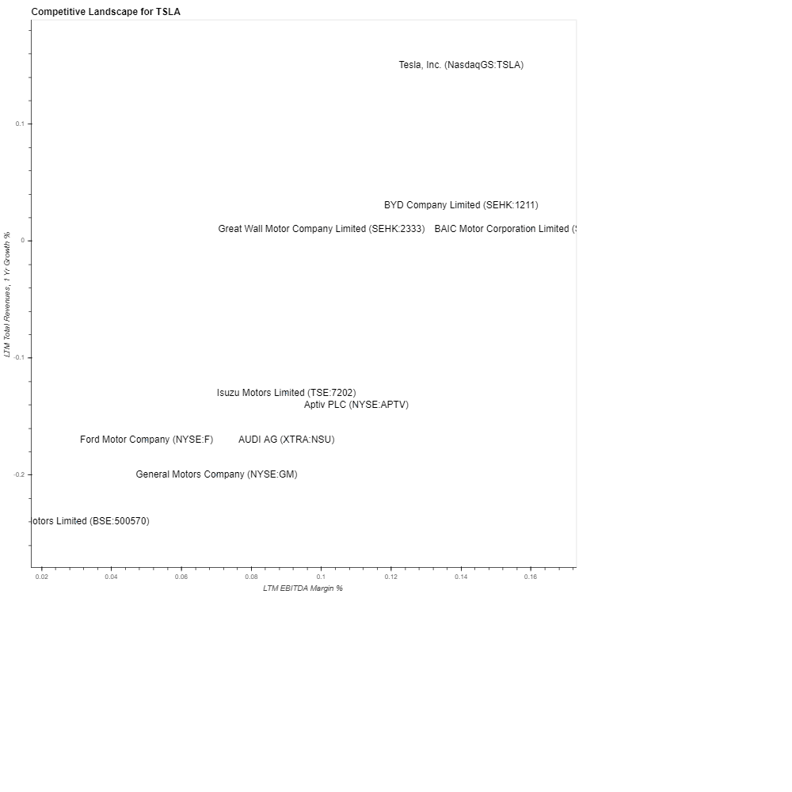
TSLA-Financial Analysis
Revenue
3
Source ：Factset, Equity Research Report, FS. Note 1, adjusted EBITDA = EBITDA excludes share based payments

